Slide 1
Lecture 6 (Internal Flow – this material is not covered in the textbook)
Objectives
Formulate and solve convective heat transfer in a fluid flowing inside Tubes and Ducts.
Describe velocity boundary layer and thermal boundary layer developments of this flow
Determine the temperature of a liquid flowing in a tube as a function of the axial distance (i.e. direction of the tube)
Define mean temperature – application to heat exchangers – Unit Operations
Applications

Slide 2
Boundary layer development in a pipe
Viscous Effects
are important
Velocity is not
any longer
function of x
Entry Velocity
Inviscid (no viscosity effect) flow region

Slide 3
Velocity boundary layer Hydrodynamic Entrance Effects
Laminar versus turbulent
Hydrodynamic entrance length. When the flow starts to be fully developed?
Turbulent Flow starts
Laminar Flow
Turbulent Flow
Practically

Slide 4
Mean Velocity Concept
R
r
r
R

Slide 5
Thermal boundary layer development
Surface conditions – there are two conditions:
Constant temperature at the surface (T_{w}) and
Constant flux (q”_{w} ) or flow
Thermal
Boundary Layer
Development
T_{w} >T (r)
q”_{w}
Temperature
r
Temperature
Thermal
Entrance Region
x
Fully
-
developed
Region

Slide 6
Thermal boundary Layer development
Fully developed region is different than the velocity boundary layer because we can have either constant wall T or constant wall q”
Thermal entrance region
Laminar Flow
Turbulent Flow

Slide 7
Thermal boundary layer
Two Surface Conditions will be considered
T_{w} >T (r)
q”_{w}
Temperature
T (r)
r

Slide 8
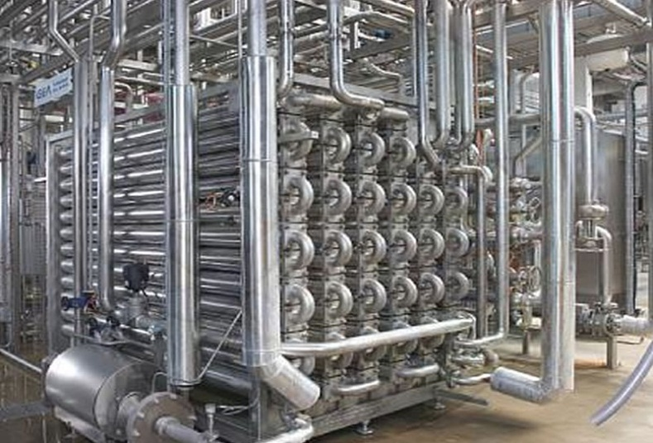
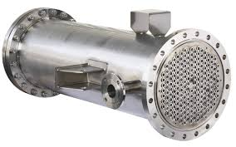
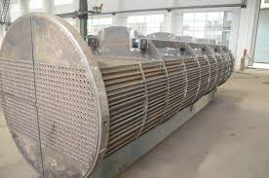
Mean Temperature Concept
Different Types of Heat Exchangers

Slide 9
Mean temperature Concept
Temperature profile
at a given r
T(r,x)
r
Reminder
x
Two problems are considered, either
a constant temperature or
a constant flux at the boundary
T(r,x)
The objective is reduce the temperature to be only a function of one variable

Slide 10
Mean temperature Concept
Mean temperature for an incompressible flow inside a circular pipe is defined using an energy balance (for the developed flow):
?

Slide 11
Heat Transfer for Convection
We can use the mean temperature
in a local version of Newton’s law of cooling
T_{w}

Slide 12
Concept of Mean Temperature
To find an analogy to the fully developed velocity profile we must realize that
While heat transfer continues to occur, the magnitude of the temperature profile will change BUT, its relative change may become fixed
When the relative change becomes fixed we have thermally fully developed flow
Wall Temperature

Slide 13
Concept of Mean temperature
This will occur for either uniform wall temperature (T_{w} = constant) or uniform wall heat flux (q’’= constant)

Slide 14
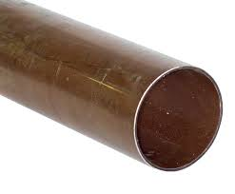
Temperature profile
Let’s develop an expression for the mean temperature using energy conservation (for an incompressible fluid)
For example
for a cylinder
Perimeter
x
For

Slide 15
Temperature profile
For non-constant and constant heat flux :
Non-constant
Constant
For constant surface temperature T_{w}

Slide 16
Axial Temperature Variations
constant flux q”_{w}
constant temperature T_{w}
Fully Developed Flow
Fully Developed Flow
x
x
or
U determined using techniques introduced
in Steady State Heat Transfer

Slide 17
Convection coefficients
Why are they needed ?
We have developed expressions for the axial variation in mean temperature, and from those expressions equations for the heat transfer. All these expressions require convection coefficients

Slide 18
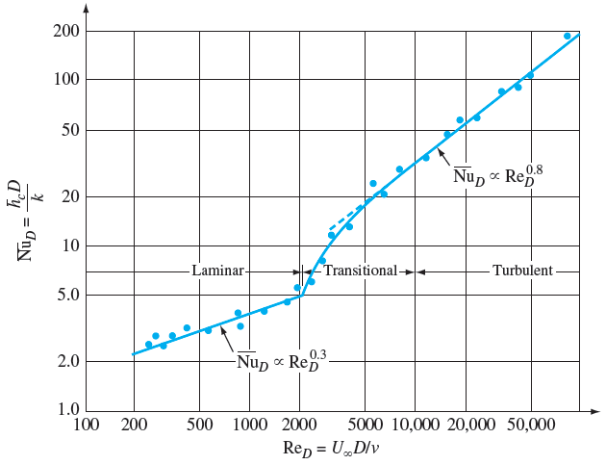
Convection coefficients

Slide 19
Convection Coefficients Calculations
Assume laminar flow, fully developed, uniform
surface heat flux
Assume laminar flow, fully developed and uniform surface temperature

Slide 20
Convection coefficients
When Re is high enough for fully developed
turbulent flow (either constant heat flux or
constant wall temperature), we could use
the following correlation:
With n = 0.4 (heating); n = 0.3 (cooling)

